Slide 1

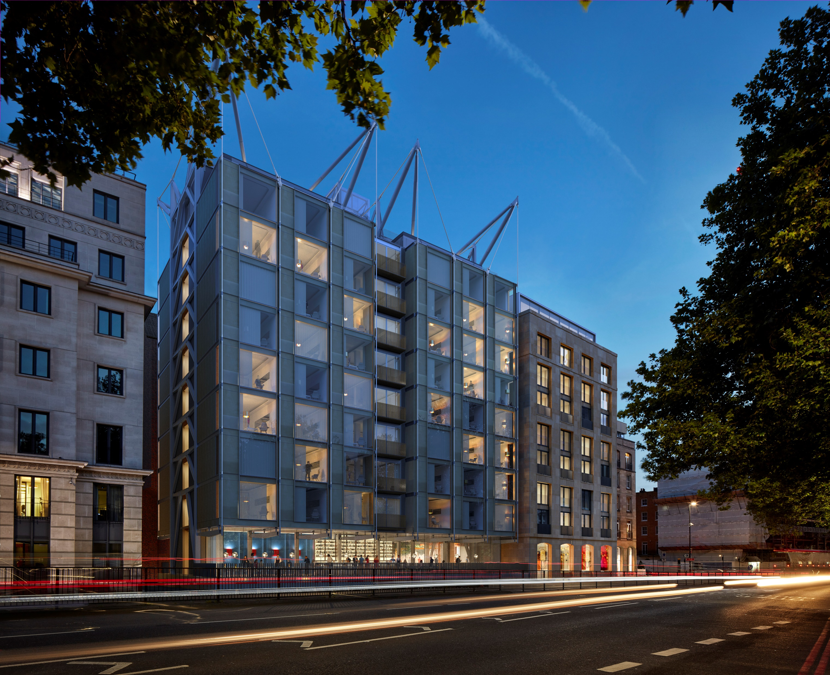
Background: CANVAS #FDFBF7, no boxes
LINES: SERPENTINE #180EC2
Text: LAMP BLACK #020301,
Text font: Founders Grotesk
Text size: 10
Dear Mr,
Thank you for taking the time to contact us. I am sorry that we will not be able to welcome you to The Berkeley on this occasion, and have cancelled the below reservation as you requested.

Slide 2

The Emory, Old Barrack Yard, Belgravia, London, SW1X 7NP
Reservations Number
Main Number
FOOTER
Text: TITANIUM WHITE #FFFFFF
Background: LAMP BLACK #020301

